Slide 1

Analysis of
Analysis of
Metro Bike Share
Metro Bike Share
Ankit
Casey
Dido
Sijia
Song
Jain
Kan
Chang
Li
Han
Jain
Kan
Chang
Li
Han
Group 4

Slide 2


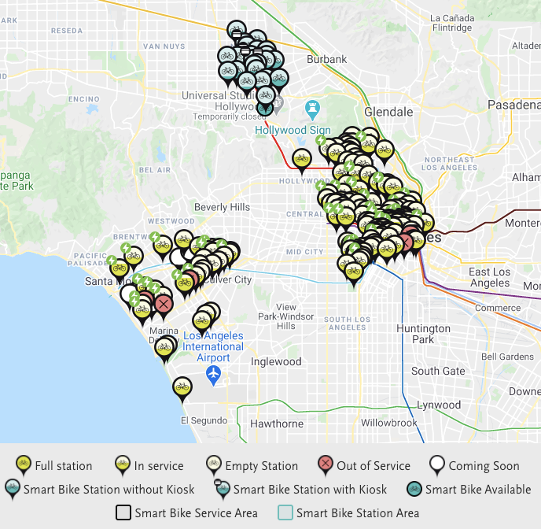


What is it ?
Metro Bike Share is a bicycle sharing system in Los Angeles
Launched in 2016
Downtown & Central LA
Westside
North Hollywood

Slide 3
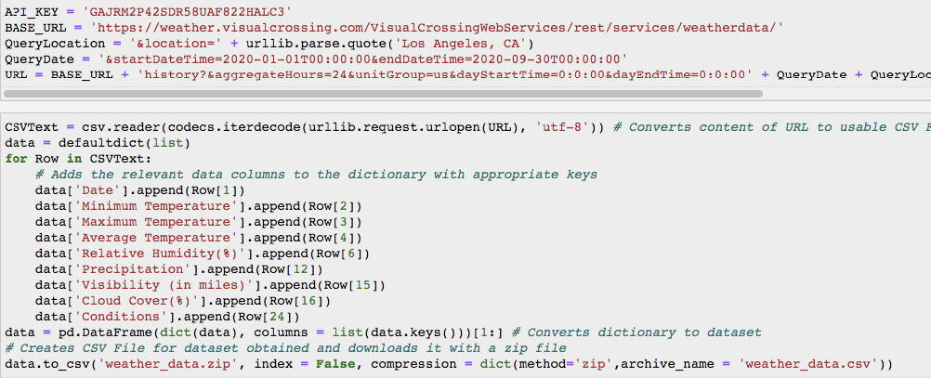
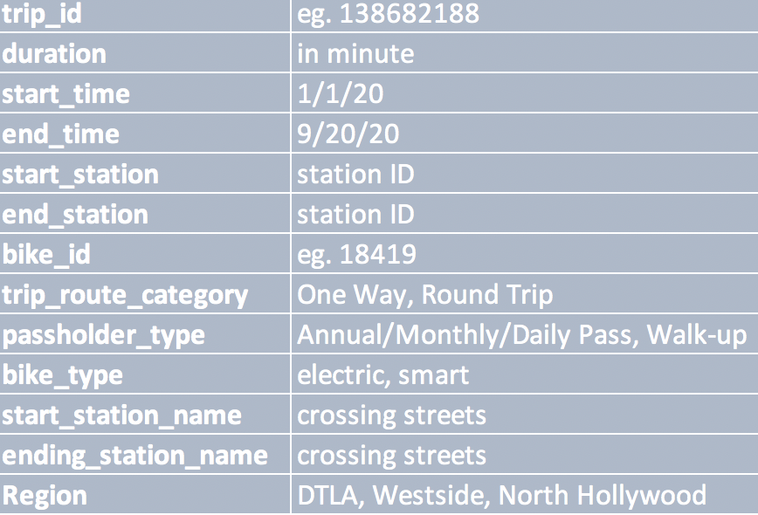
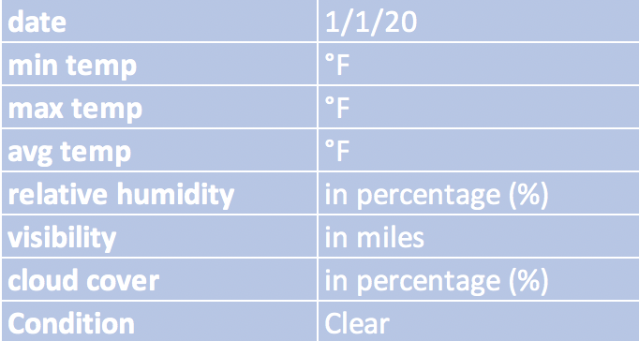
Acquiring and Preparing Data
Weather API

Slide 4
General Statistics
Observed period
Jan
Q1
Q2
Q3
Sep
274 days
Total Number of Bike Rental Trips
2133 bikes
172097 times
Average Number of Trips per Day
☀️
628 times rental
🌙
Average Duration Per Trip
37.15 min
Notes:
From 4 - 6pm most trips (off from work), decreases after 6pm
Most trips within afternoon hours

Slide 5
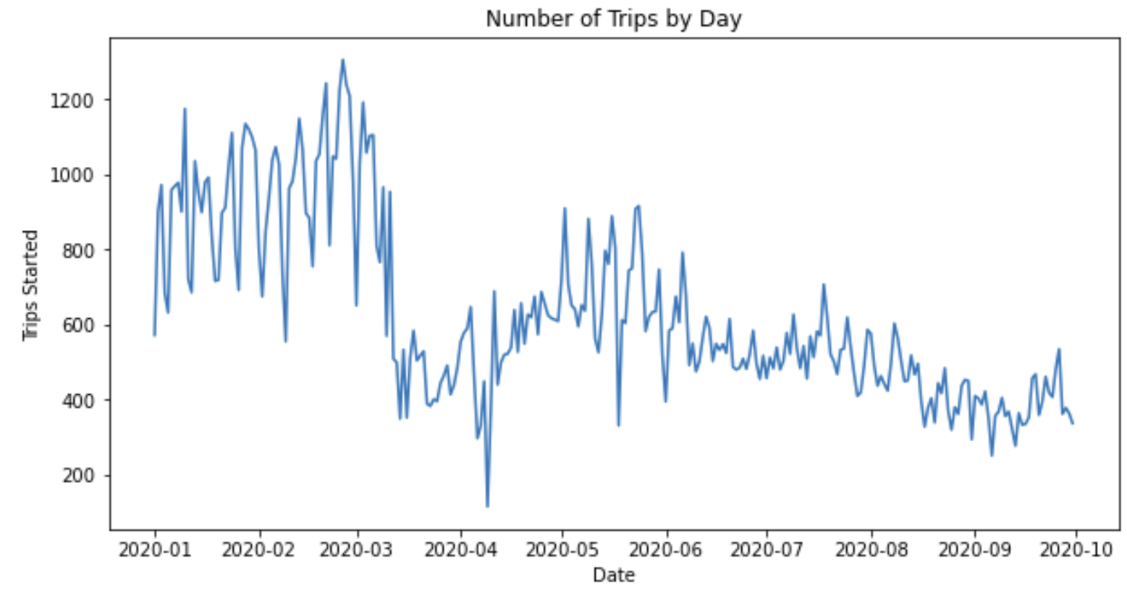
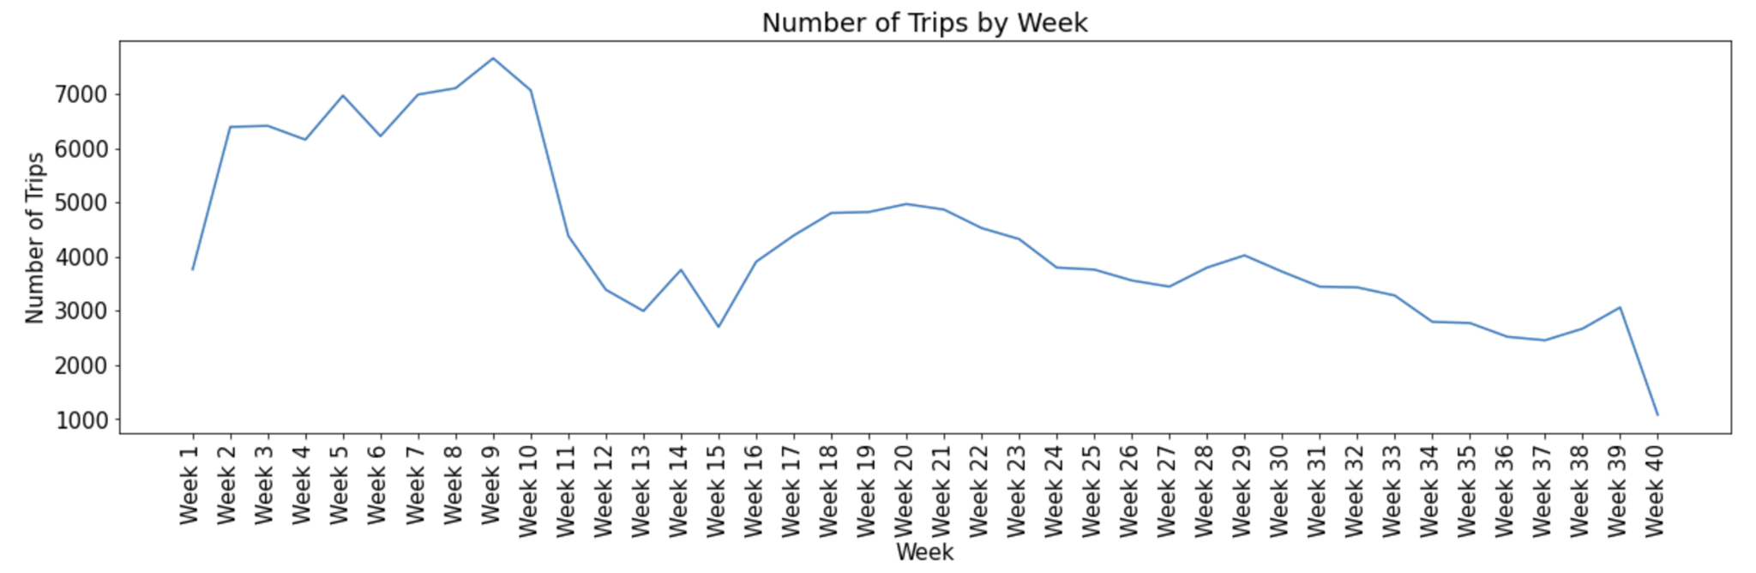
General Observations
Weekly
Daily
Notes:
From 4 - 6pm most trips (off from work), decreases after 6pm
Most trips within afternoon hours

Slide 6
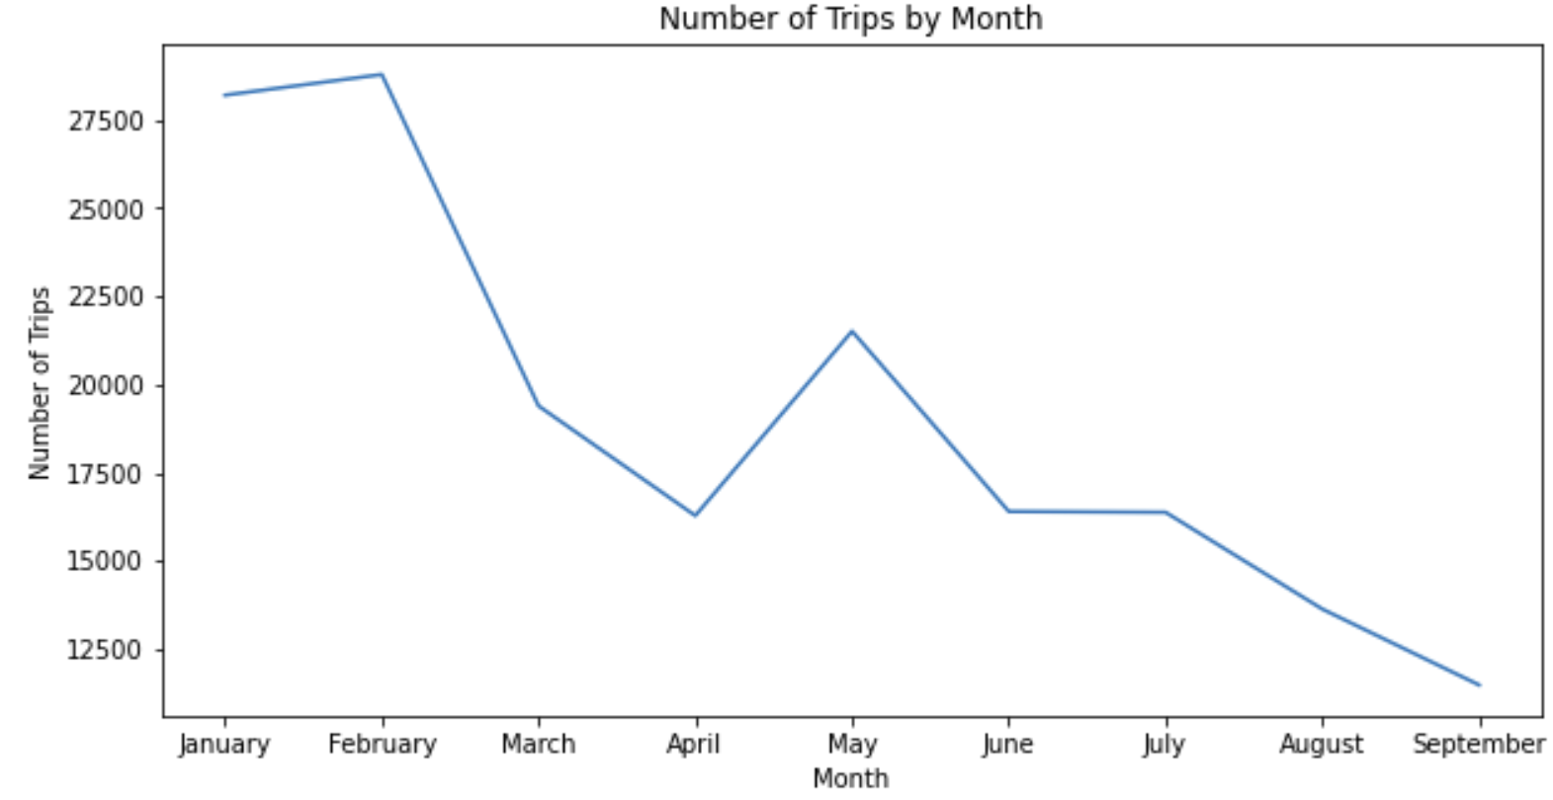
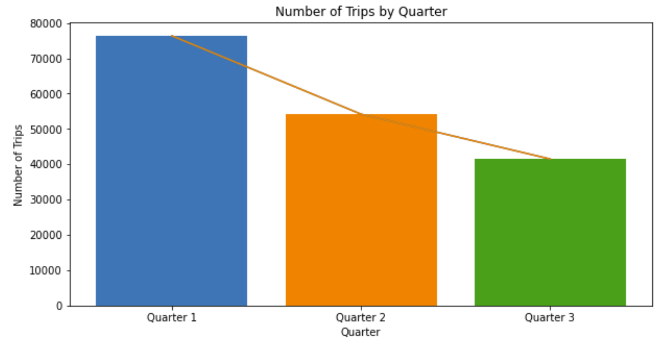
General Observations
Quarterly
Monthly

Slide 7
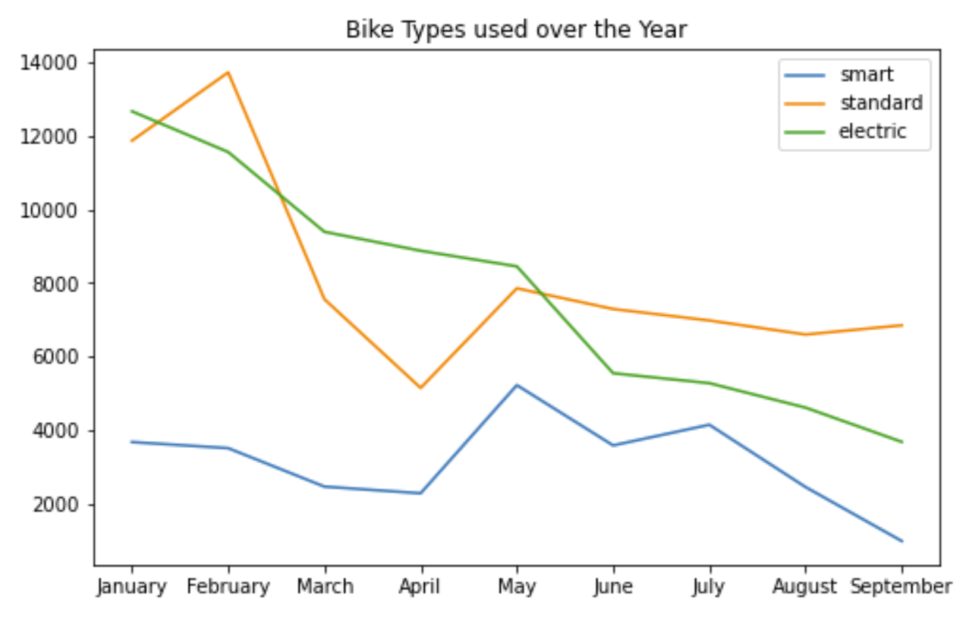
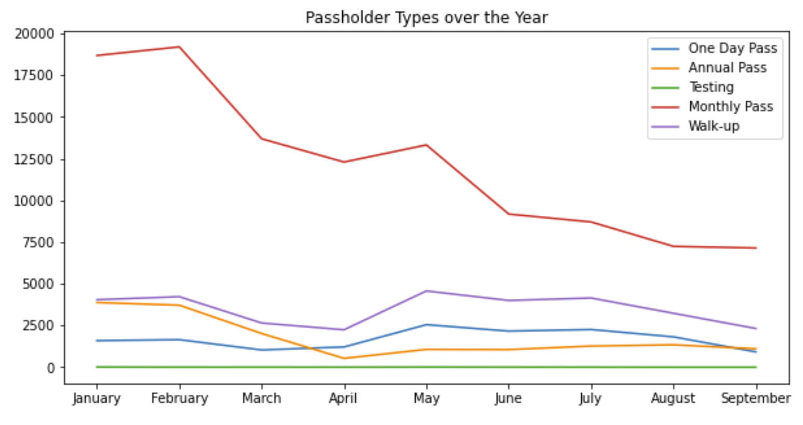
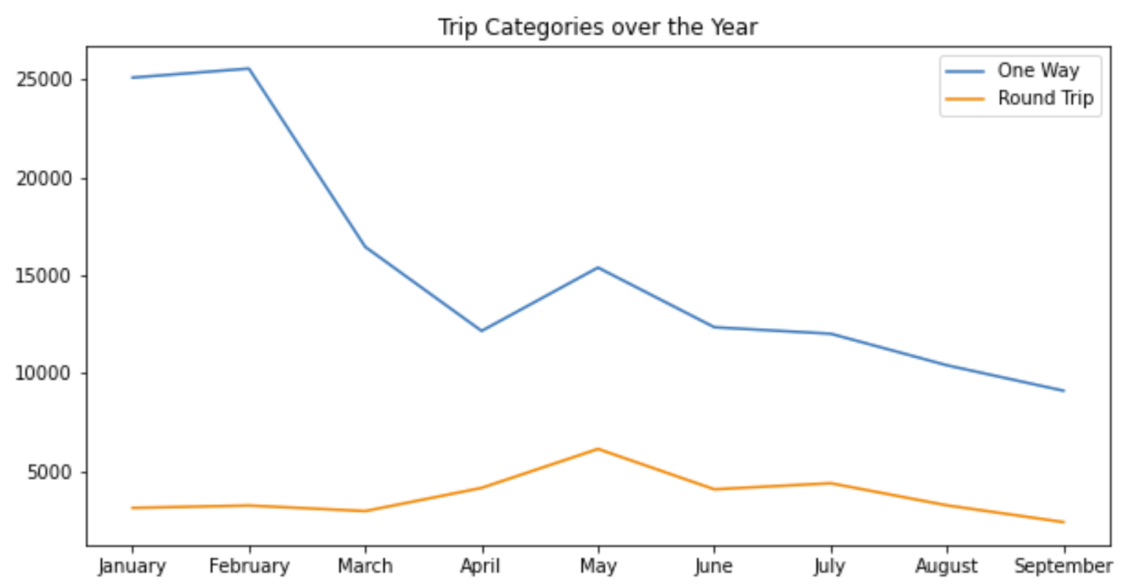
General Observations
Bike Type
Pass Type
One Way/ Round Trip
Notes:
From 4 - 6pm most trips (off from work), decreases after 6pm
Most trips within afternoon hours

Slide 8
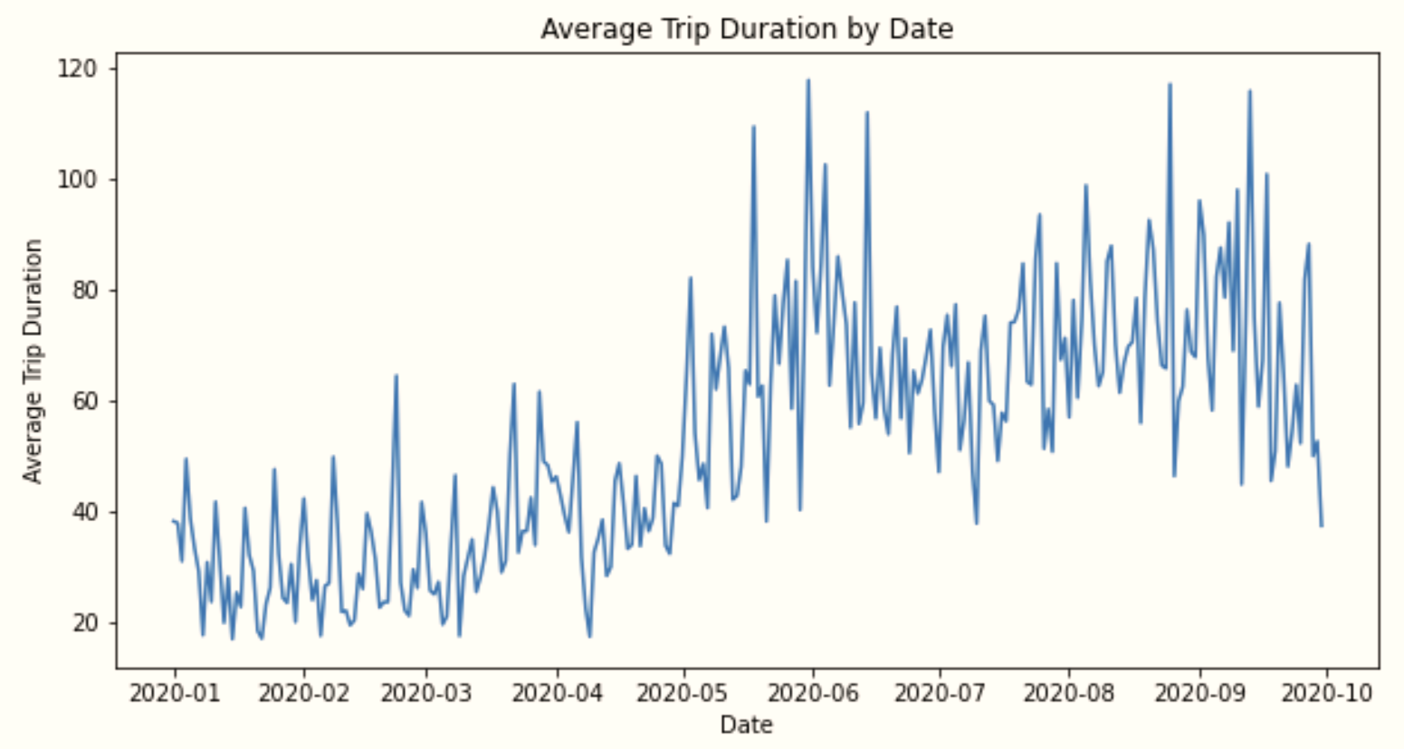
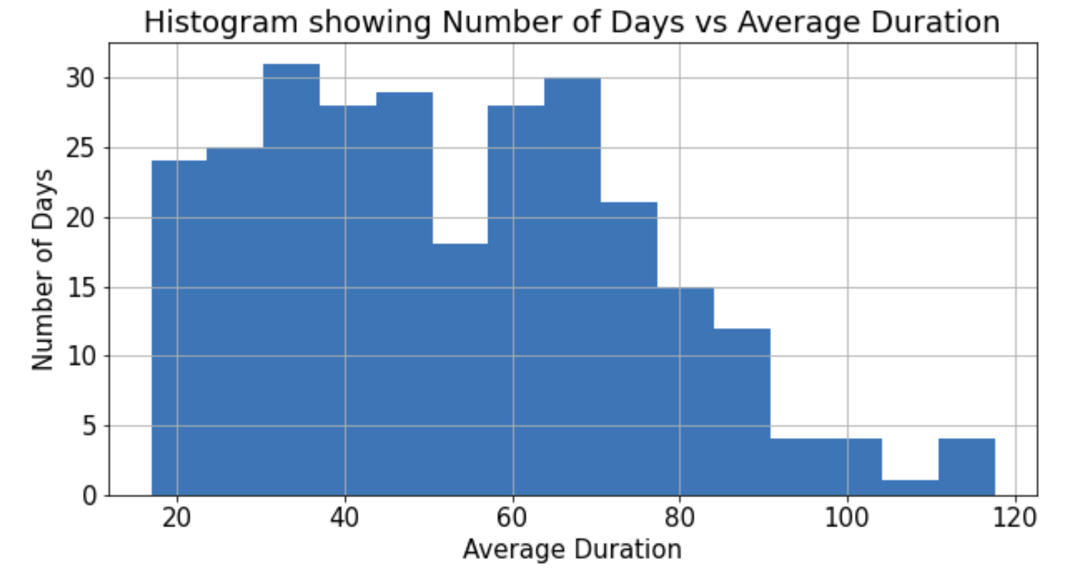
General Observations
82°F
Temp
68°F
Jan
Aug

Slide 9
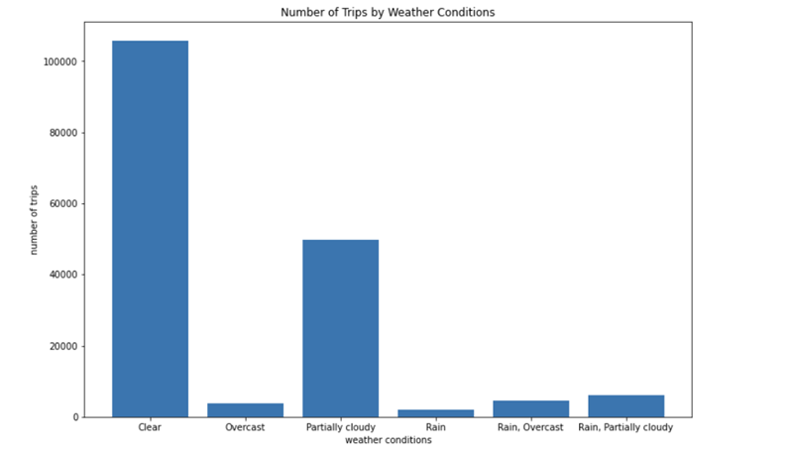
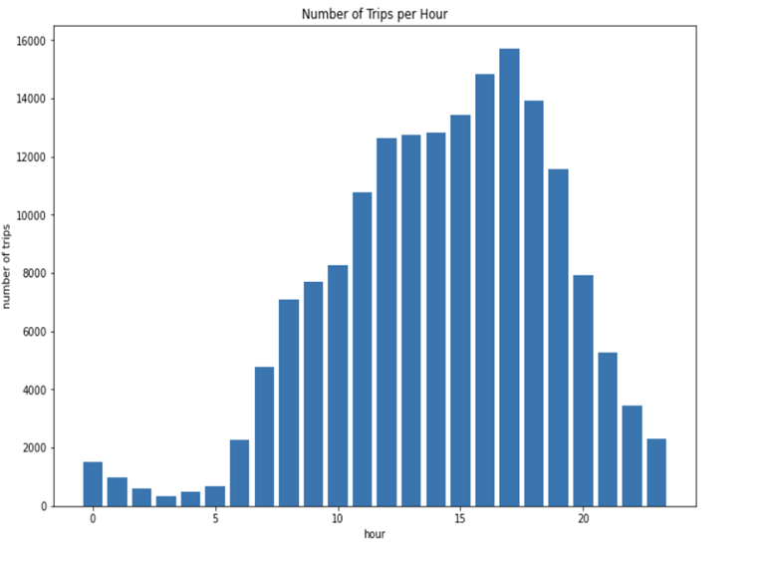
Number of Trips by Weather Condition & Hourly Activity
☀️
Most active rental
3-6pm
⛅️
🌧
Highest : Clear days
Lowest : Rainy days
Most trips : Clear and partially cloudy days
5pm
Notes:
From 3 - 6pm most trips (off from work), decreases after 6pm
Most trips within afternoon hours

Slide 10
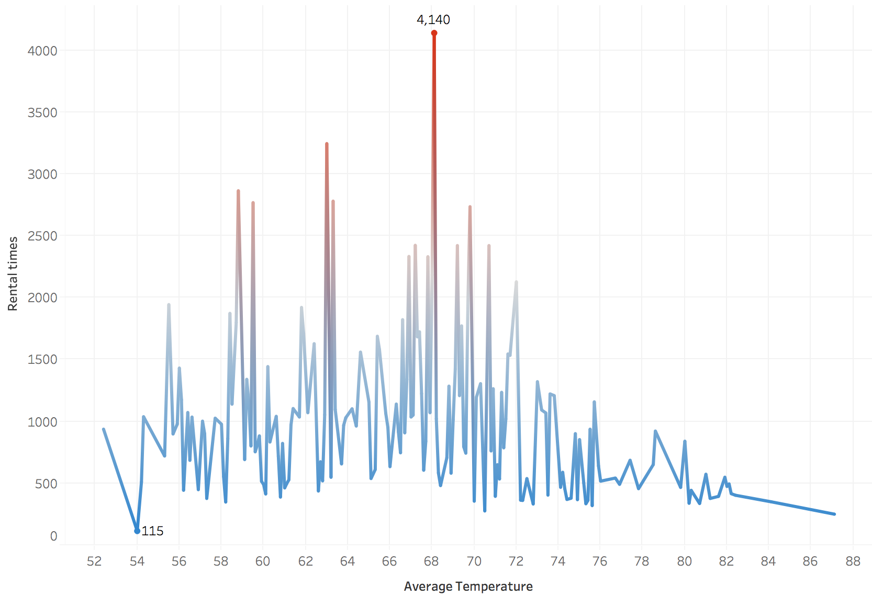
Number of Trips by Average Temperature
Max at 68.1 °F
Most trips : cooler days (high 50 to mid 70 degrees)
Min at 54.0 °F
Notes:
More trips on cooler days
Most trips within the high 50s to mid 70s

Slide 11
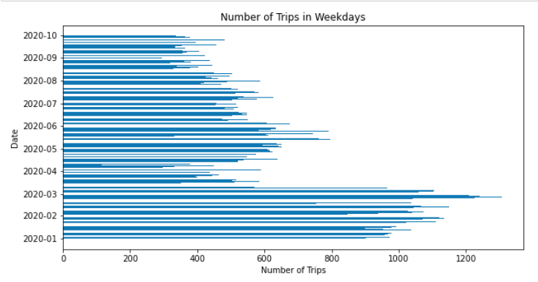
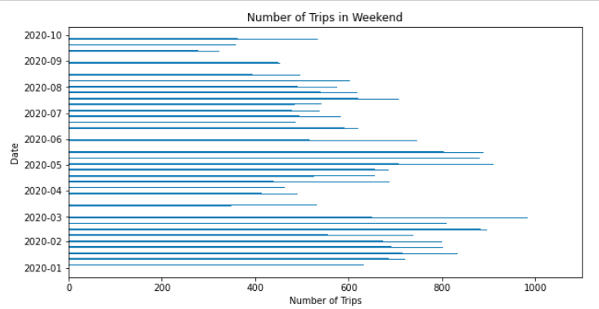


Weekdays Vs. Weekend - Number of Trips
Weekdays
Weekends
Notes:
Shared bikes are used more often in the weekdays
Average Number of Trips in Weekdays: 632.35
Average Number of Trips in Weekend: 617.38

Slide 12
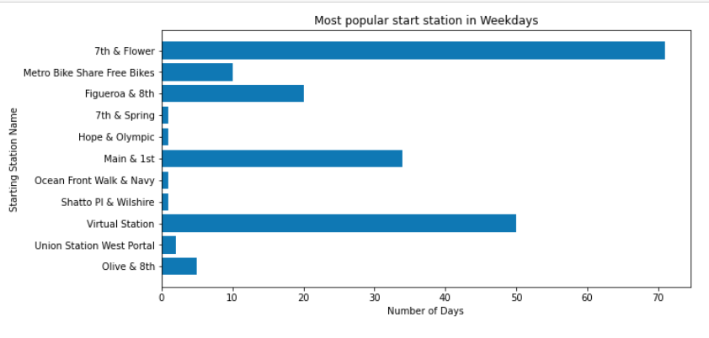
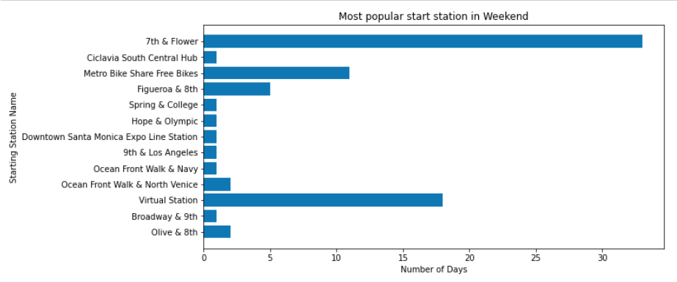
Weekdays Vs. Weekends - popular stations
Weekdays
Weekends

Slide 13
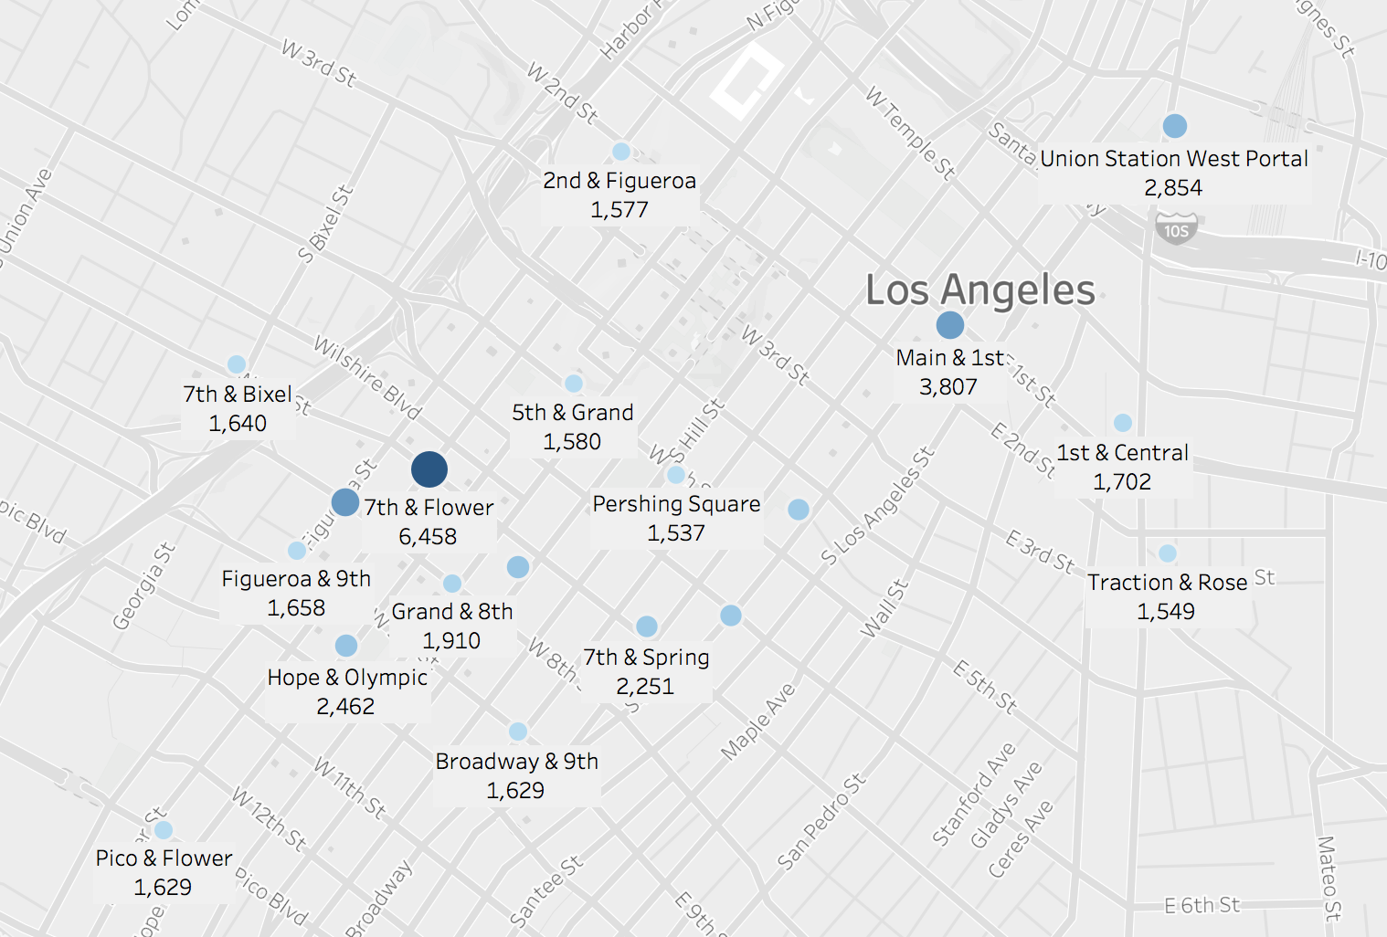














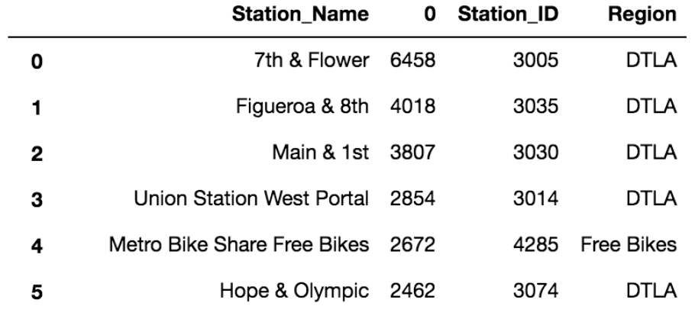
Popular stations
Hall of Justice
Financial District
City Hall
Notes:
Top 5 popular stations on the list, the common facts of them that they are either located at business center or near government agency.

Slide 14
Conclusions & Improvements
Conclusions:
1. Pandemic has a huge influence on the bike rental business. The number of trips keeps decreasing since February.
2. Most trips are within afternoon hours, especially in 3-6 pm.
3. Most trips happen in days with the temperature between 50s to 70s.
4. The CBD of LA tends to be the most popular station on both Weekdays and Weekends.
5. The usage rate of shared bike is higher on Weekdays than that on Weekends.
Notes:
Dido： since we got time cut to 8min, not really suggest mention all above, maybe pick one or two interesting/important and move on to the next slide.
Song: I will choose two conclusions to share depending on time left, since these conclusions are all well explained in the previous slides, I will just quickly go through and not give further explanations.

Slide 15


Recommendations & Improvements
Improvements:
Season Pass
Weekend Promotions
Reward Program
Users information
Revenue
Notes:
Since most of people tend to use the electronic bikes with one-day pass on weekdays, we should add more season pass and weekend promotions to give possible incentives for usage of smart bikes, round trips, and the purchase of monthly & annual passes to bring in more revenue from those outlets.
Besides, adding possible competitive element for users to race with cycles in most popular routes with incentives and prizes given to winner is also a good way to attract more users.
Song: Thanks for the advice, but I’m not sure if we need to say this point:
-emphasize on exercise and physical activity provide by bike share service which is something needed by users especially during the pandemic when we can’t go anywhere and emphasize the precautions taken by the company
To get further analysis:
The dataset lacks of users information, like gender, age, job, ect, with which we can do more analysis on bike users.
Revenue and price information that are missing are also essential for us to do the analysis in financial domain.

Slide 16
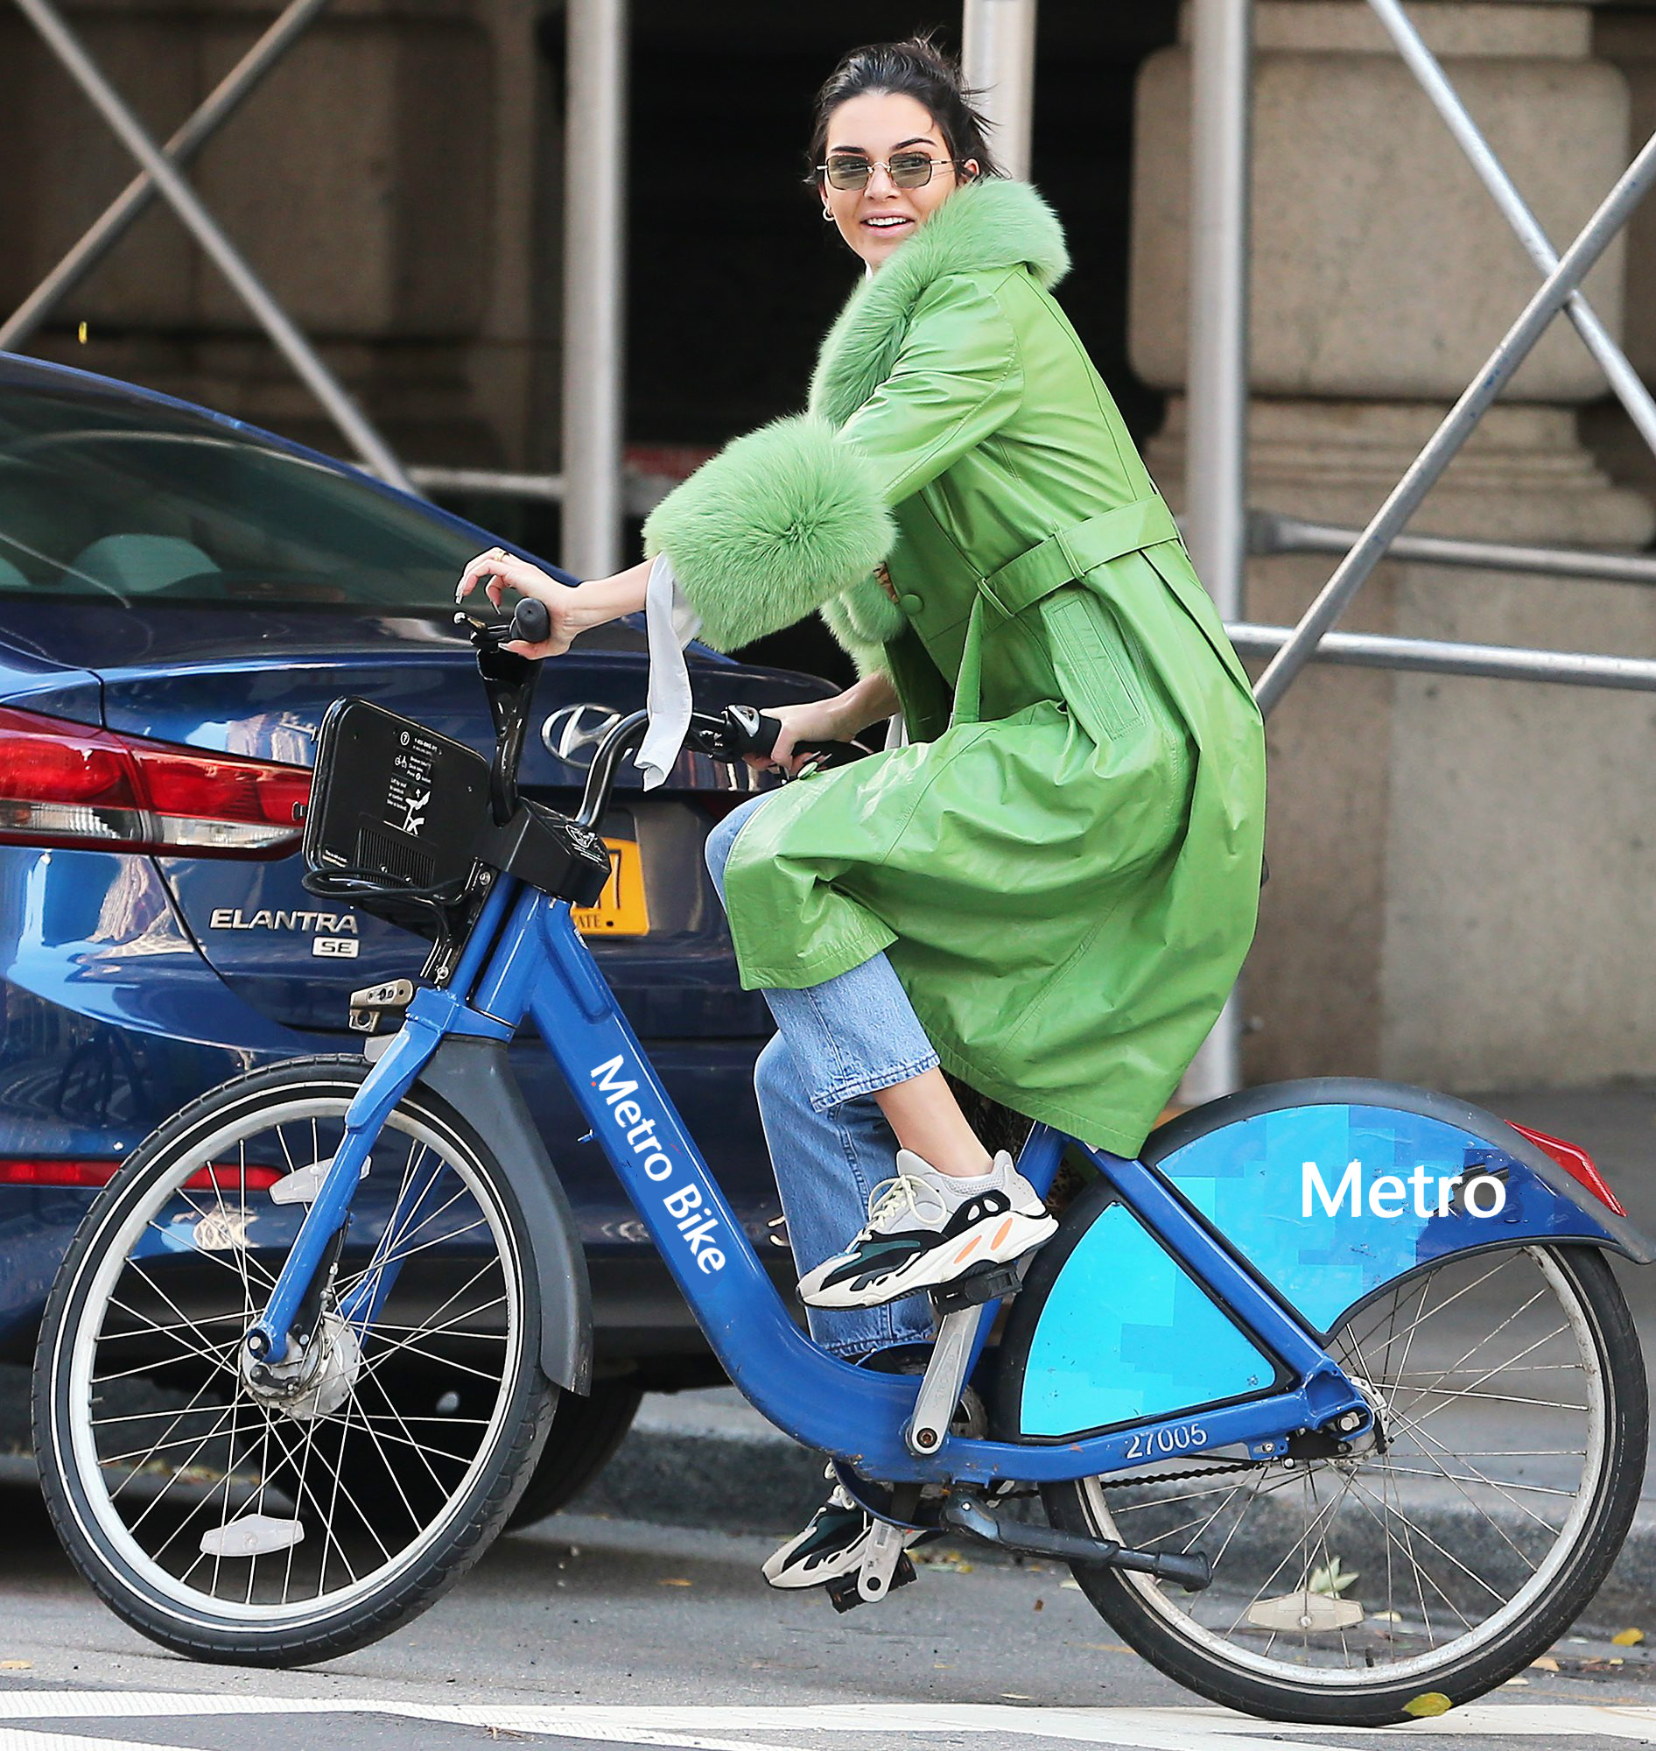
What you waiting for ?

